Slide 1

Fake News Detection
Getting to the truth in an era of misinformation
By Adam Cumurcu

Slide 2
Business Case
Fake news has been on the rise this past decade
Denying the 2020 election results
Spreading misinformation about the COVID vaccine
Breakdown of shared reality
One of the main sources of fake news is social media, such as Facebook and Twitter
2019: 8 percent of engagement with the 100 top-performing news sources on social media was dubious
2020: this number more than doubled
Most popular news platform on Facebook in 2021: The Daily Wire
A fake news detection system like the one I aim to produce can be used by social media companies to filter out misinformation.

Slide 3
Modeling Roadmap
Obtain Data
Cleaning & EDA
Modeling
Deployment
MILESTONE 1
MILESTONE 2
MILESTONE 3
MILESTONE 4
Download the data from Kaggle
Preprocess data
Perform EDA
Create simple models
Optimize models through hyperparameter tuning
Create a web app using Streamlit

Slide 4
Data Understanding
Date source: ‘Fake and real news dataset’ from Kaggle.
21,417 real articles from Reuters
23,481 fake articles from various sources.
Period covered: January 2017 to December 2017.

Slide 5
Data Preparation
Only looking at the articles, not the titles, subject or date.
Data preparation steps:
1. Use regex to remove the names of the news outlet and city of origin from the real articles.
2. Use Spacy to tokenize the text of the articles and remove stop words.

Slide 6

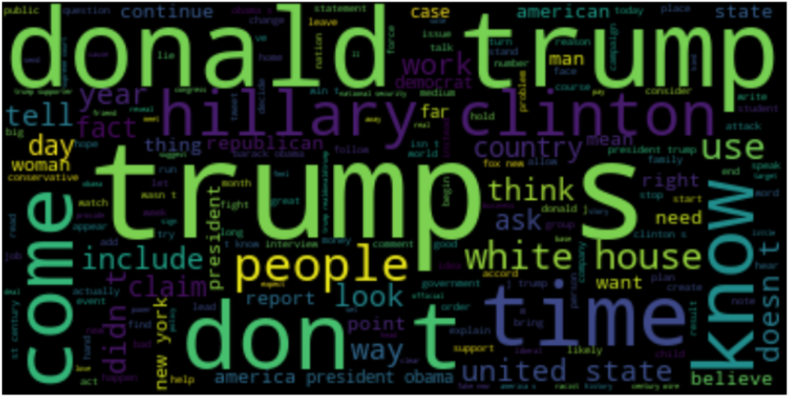
World Cloud Visualization
Real Articles
Fake articles

Slide 7
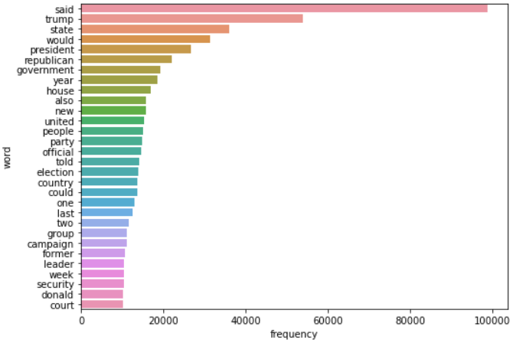
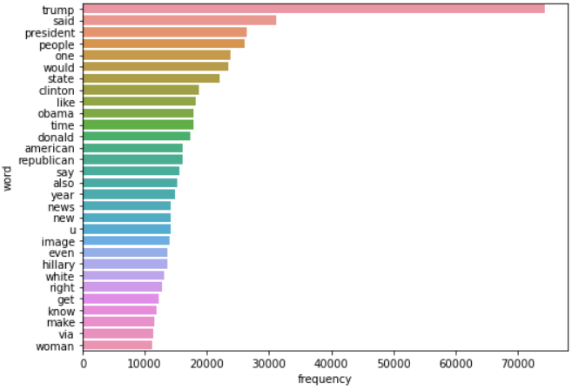
Unigram Frequency Distribution
Real Articles
Fake Articles

Slide 8
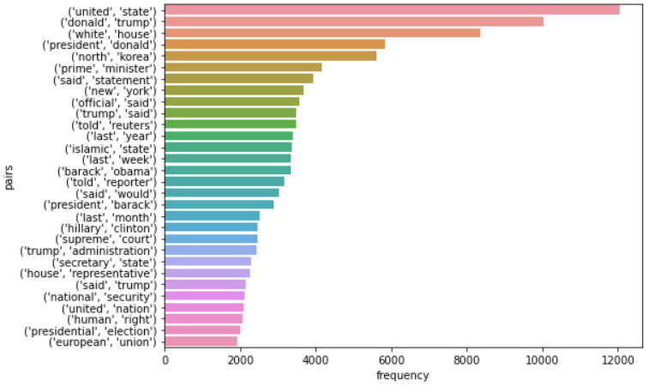
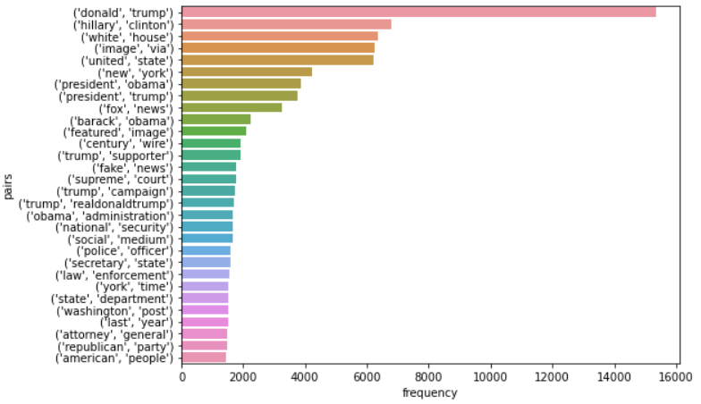
Bi-gram Frequency Distribution
Real
Fake

Slide 9
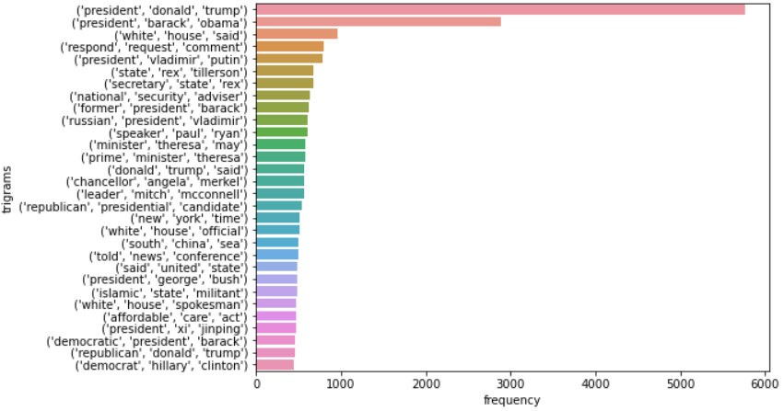
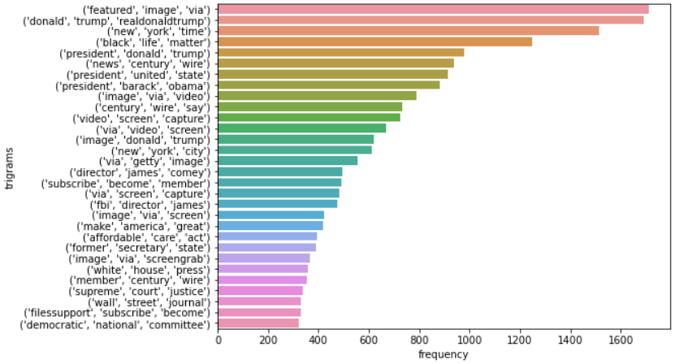
Tri-Gram Frequency Distribution
Real
Fake

Slide 10
Modeling
1. dummy classifier to check the baseline score.
2. LogisticRegression
3. Multinomial Naïve Bayes
4. Random Forest
5. Voting classifier (LogisticRegression, Multinomial Naïve Bayes and Random Forest)
Best Results: LogisticRegression
Scoring: f1 (not overly concerned with false positives or negatives)
Initial split: 0.25, which resulted in an f1 score of 0.99.
Subsequent split (to address overfitting): 0.5, which resulted in an f1 score of 0.98

Slide 11
Modeling Results
Model | Training F1-Score | Testing F1-Score
Logistic Regression | 1 | 0.99
Multinomial Naïve Bayes | 0.96 | 0.94
Random Forest Classifier | 1 | 0.95
Voting Classifier | 1 | 0.98

Slide 12
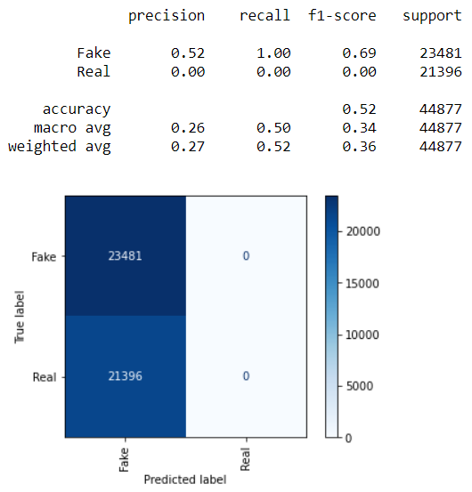
Dummy Classifier

Slide 13
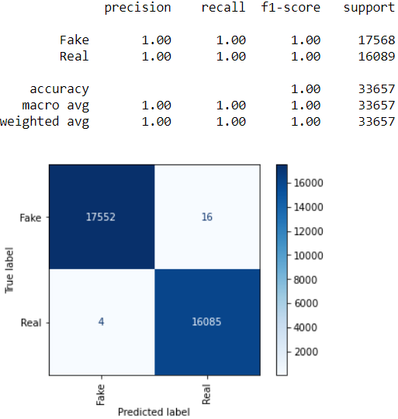

Logistic Regression Gridsearch Results with Split Set to 0.25
Training Set
Test Set

Slide 14
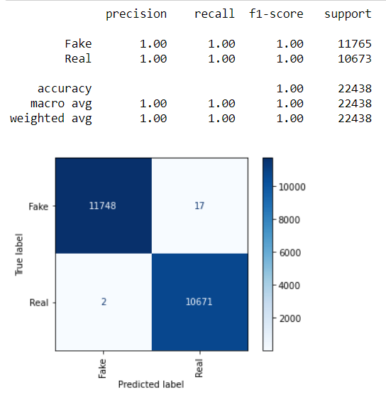
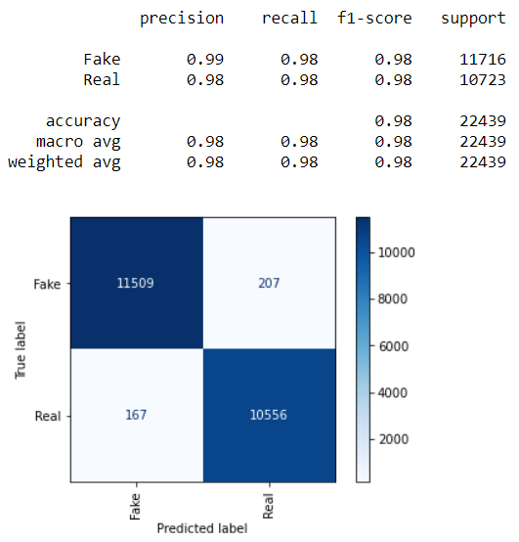
Logistic Regression Gridsearch Results with Split Set to 0.5
Training Set
Test Set

Slide 15
Next Steps
Deploy web app so that anyone can verify if an article is real or fake.
Train model on newer articles to keep it up to date.

Slide 16
Thank you
Adam Cumurcu
Email: acumurcu@gmail.com
Github: http://github.com/AdamCumurcu
Linkedin: http://linkedin.com/in/adam-cumurcu
Blog: http://acumurcu.medium.com/

